Slide 1

Web Search Engine
COMP 8547: Advance Computing Concepts
Prepared By: Group 12
Aayushee Dave(110023928)
Manan Parmar (110022360)
Rahul Pandya(110024678)
Richa Gupta(110013520)

Slide 2
Contents
Introduction
Concepts
Block Diagram
How the application works?
Code Walkthrough
Demo
Conclusion
References
Credits

Slide 3
Introduction
The web search engine takes user input to be searched and provides accurate reference links based on efficient concepts (data structures and algorithms) used in development of the system.

Slide 4
Concepts
Web Crawler using BFS (Breadth First Search)
Jsoup (HTML to text conversion)
Tries
Autocomplete
Java Regex
Sorting (Quick and Insertion sorting)
String Tokenizer

Slide 5
How the application works?
User searches for a word/text.
Web crawler crawls the web pages for relevant results.
Jsoup HTML parser converts web pages to text format.
The text is converted to Tries.
Web crawler gives the list of results(URL, Title, Description, Tries).
Results sorted using Quick and Insertion Sort algorithm.
Display Results

Slide 6
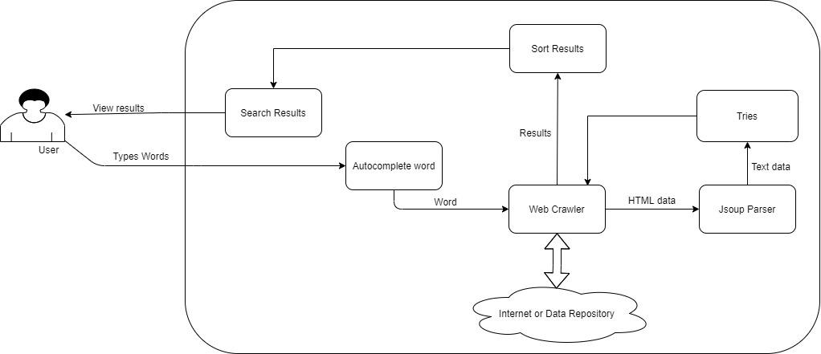
Block Diagram

Slide 7

Code Walkthrough

Slide 8
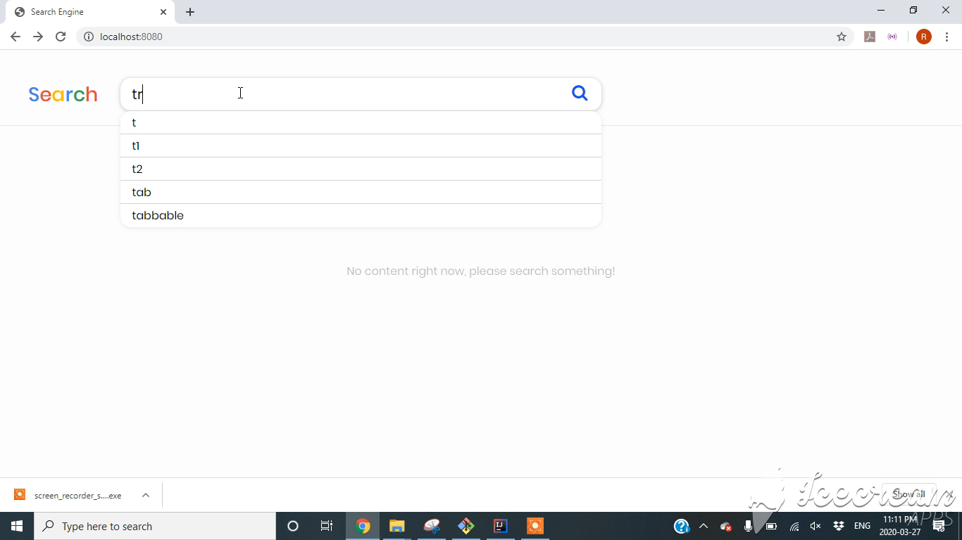
Demo

Slide 9
Conclusion
We learnt to implement various concepts to create real world application. Also, we learnt to recognize which algorithm, concept or feature would be the best suitable to create an efficient application.
Example:
Quick select or Quick sort, when?
Tries over Boyer Moore & KMP, why?

Slide 10
References
Class Slides
Java Documentation: https://docs.oracle.com/javase/8/ docs/api/overview-summary.html
Baeldung Documentation: https://www.baeldung.com/spring-boot
Web Crawler: http://www.netinstructions.com/how-to-make-a-simple-web-crawler-in-java/

Slide 11
Credits
Dr. Luis Rueda, Professor in University of Windsor
Dr. Abed Alkhateeb , Professor in University of Windsor
Rahul Bharadwaj and Musab Naik, TAs

Slide 12
Thank You

